Slide 1
Argument Writing
Standard: 9-10.WS.1. Write arguments to support claims in an analysis of substantive topics or texts, using valid reasoning and relevant and sufficient evidence.

Slide 2
ARGUMENT
An argument is a reasoned, logical way of demonstrating that the writer’s position, belief, or conclusion is valid.
Arguments seek to make people believe that something is true or to persuade people to change their beliefs or behavior.
An argument is a “text that expresses a point of view” (Lundsford 5).
This point of view is called your BELIEF.
Your BELIEF is your CLAIM in an argument.

Slide 3
CLAIM
It is your basic belief about a particular topic, issue, event, or idea
It is not just an opinion. It is what you think is TRUE based on what you know.

Slide 4
Example Claims
Some women in the workplace are underpaid.
Smokeless tobacco could be more harmful than cigarettes.
Standardized tests could devalue the purpose of instruction.
Most of the present generation lacks the discipline to live a technology-free life.
The previous examples reflect my BELIEFS, aka my CLAIMS. These are MY OPINIONS. My next step would be to formulate my argument.
An arguer can AGREE, DISAGREE, or QUALIFY a claim (support, refute, qualify; defend, challenge, qualify).

Slide 5
WAYS TO SUPPORT A CLAIM
EVIDENCE AND REASONS

Slide 6
What is a counter claim or counter argument?
A solid and reasonable argument that opposes or disagrees with your claim
Parts of a counter claim
Concession
Rebuttal

Slide 7
Signal words in a counter claim

Slide 8
Why is a counter argument important?
It makes the argument stronger.
It gives you the chance to respond to your reader’s objections before they have finished reading.
It also shows that you are a reasonable person who has considered both sides of the debate

Slide 9
CONCESSION
Acknowledgement of the opposing viewpoint/other side of the argument
Examples:
“Dad, I know taking a trip to another country with my friends may be expensive and unsafe,….”
“Agreed that most of the students act and lie about being sick, so that they can avoid school for whatever reason,…”
“An individual does have their own right to freedom, …”

Slide 10
REBUTTAL
A written or verbal response to a counterclaim. The object of the rebuttal is to take into account the ideas presented in the counterclaim and explain why they aren’t persuasive enough, valid enough, or important enough to outweigh your own claim.

Slide 11
Rebuttal Examples
Dad, I know taking a trip to another country with my friends may be expensive and unsafe, but I have studied so hard the past year and I think I deserve a vacation. You already know how responsible I have been all my life; I don’t think there will be any problem.”
“An individual does have their own right to freedom, but medical evidence proves that second hand smoking is harmful. Nobody has the right to harm the health of another and smoking does just that.”

Slide 12
Refutation
Argue against a claim or prove it to be wrong

Slide 13
What does it mean to qualify an argument?
“Partly-agree” with another person’s argument or position but also disagree with part of it.
CLAIM: Most Americans need to exercise more.
SUPPORT According to the latest government figures, most Americans are overweight.
Qualification: However, strenuous exercise is not appropriate for those with certain health conditions.

Slide 14
Argument vs. Persuasion
An argument is expressing a CLAIM/BELIEF
Persuasion is moving people to action.

Slide 15
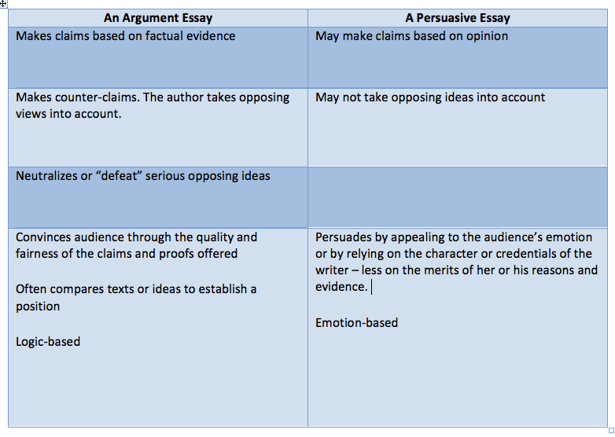
Argument vs Persuasive

Slide 16
Argument paragraph outline
Claim
Defense #1
Explanation of defense
Defense #2
Explanation of defense
Counter claim
Closing sentence

Slide 17
Counter claim paragraph outline
Topic Sentence (introduce counter claim)
Give rebuttal
Give evidence
Explain how evidence weakens the opponents claim
Closing sentence.

